Slide 1
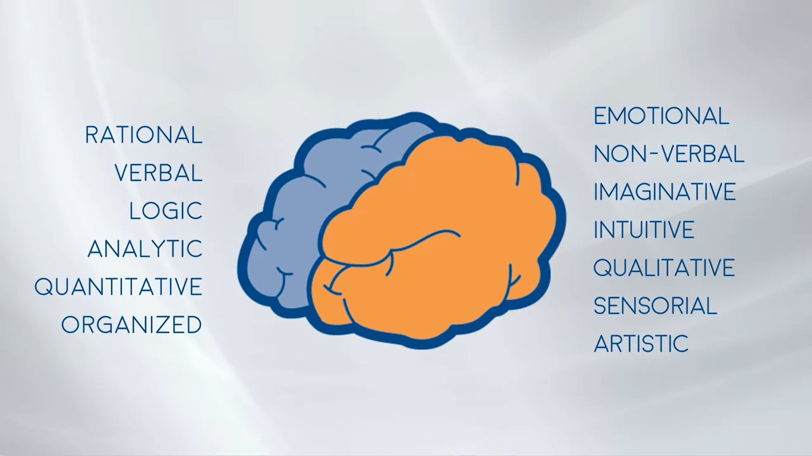
Brand and Product Management

Slide 2
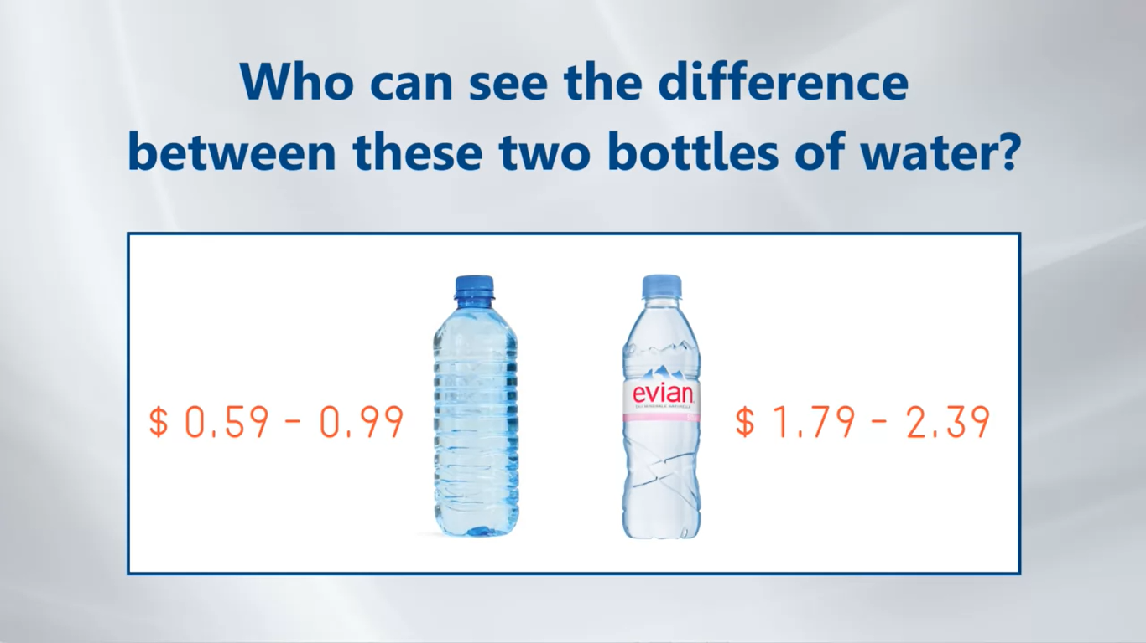

Slide 3


Slide 4
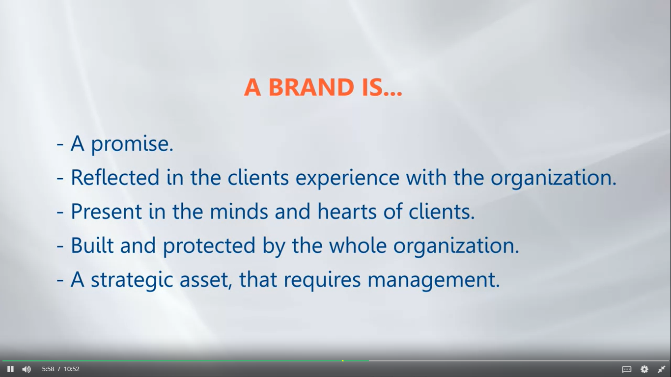

Slide 5
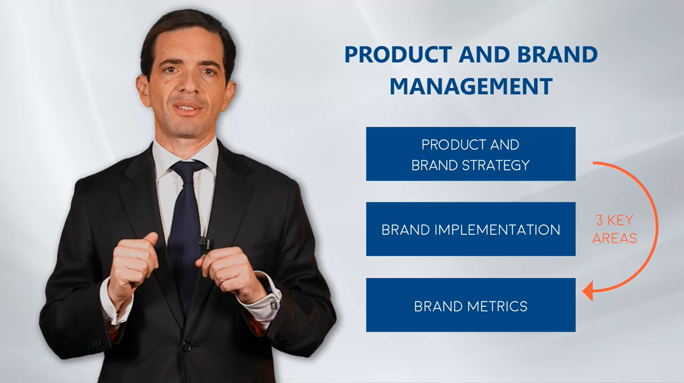

Slide 6
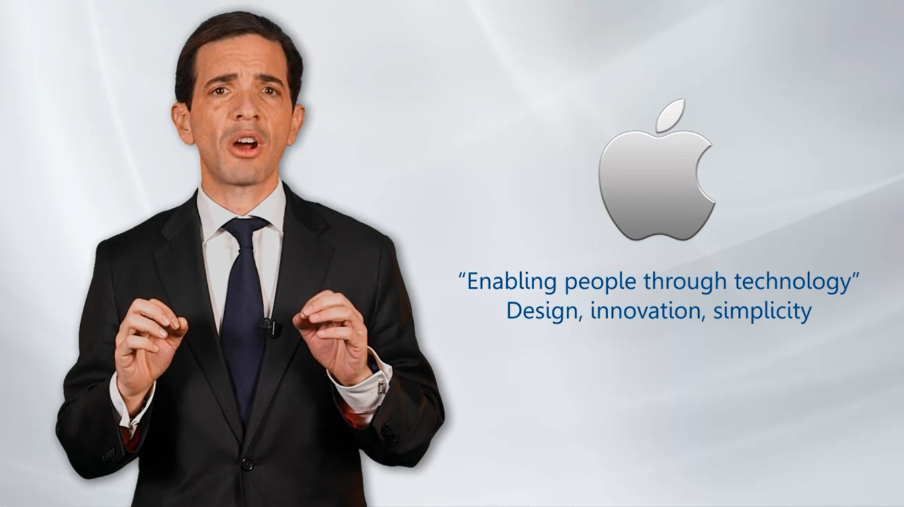

Slide 7
Understand products and product strategy

Slide 8
1.1 How do you classify new products and what is the product mix?

Slide 9
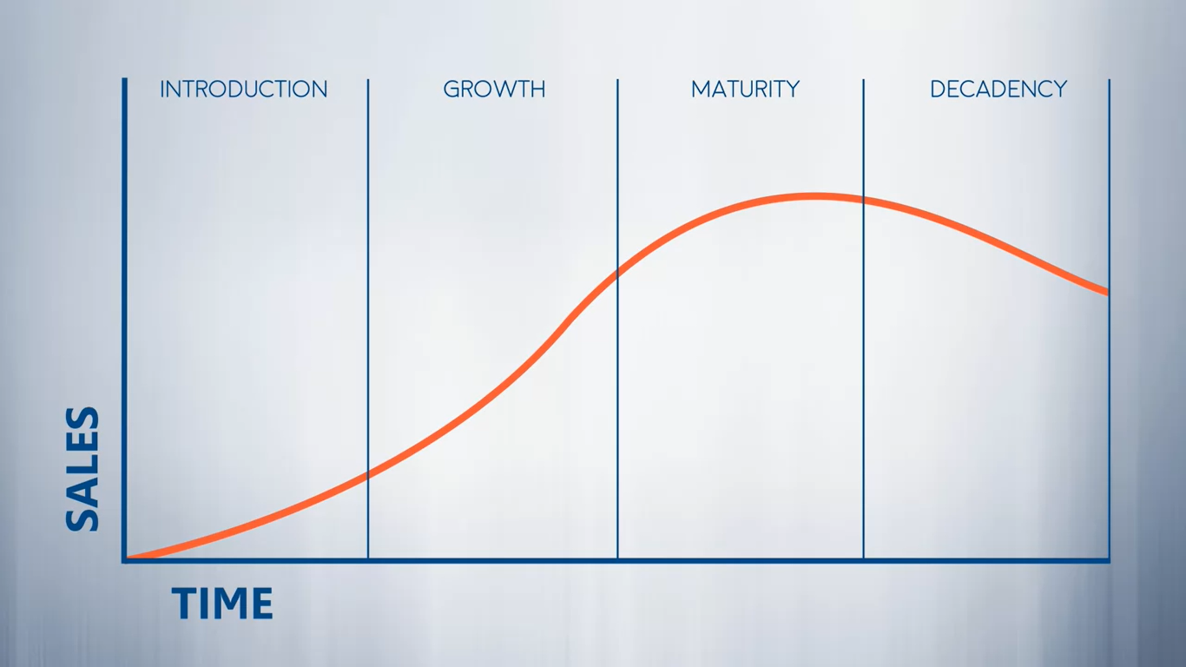
1.2 What is the product lifecycle?

Slide 10
Why Most Product Launches Fail
In order to access it click here.
Username: iecoursera1
Password: Rm0903Cour

Slide 11
FLAW 1 The company can't support fast growth.
THE LESSON Have a plan to ramp up quickly if the product takes off.
FLAW 2 The product falls short of claims and gets bashed.
THE LESSON Delay your launch until the product is really ready.
FLAW 3 The new item exists in "product limbo."
THE LESSON Test the product to make sure its differences will sway buyers.
FLAW 4 The product defines a new category and requires substantial consumer education--but doesn't get it.
THE LESSON If consumers can't quickly grasp how to use your product, it's toast.
FLAW 5 The product is revolutionary, but there's no market for it.
THE LESSON Don't gloss over the basic questions "Who will buy this and at what price?"

Slide 12
Developing and launching your product.

Slide 13
1.3 How to grow your product offering?
Understand 2 things first
Product, what is sold
And Market, to whom they sold
Managing growth effectively required that new products fit
within the firm's missions, organizational strength, and existing products.
"Who will buy this and at what price?"

Slide 14
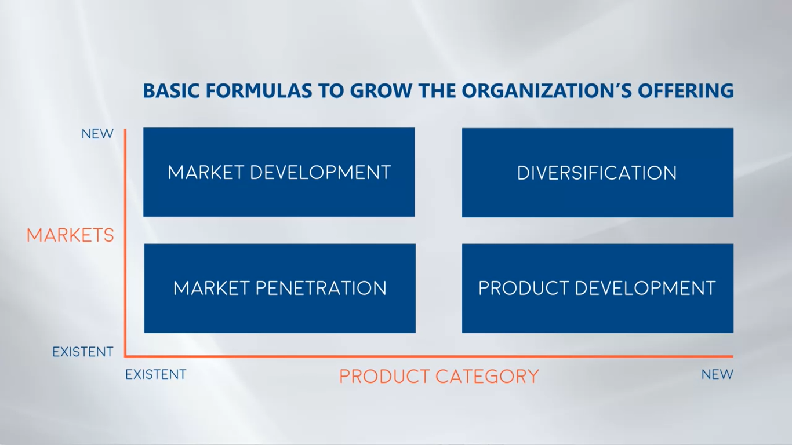

Slide 15
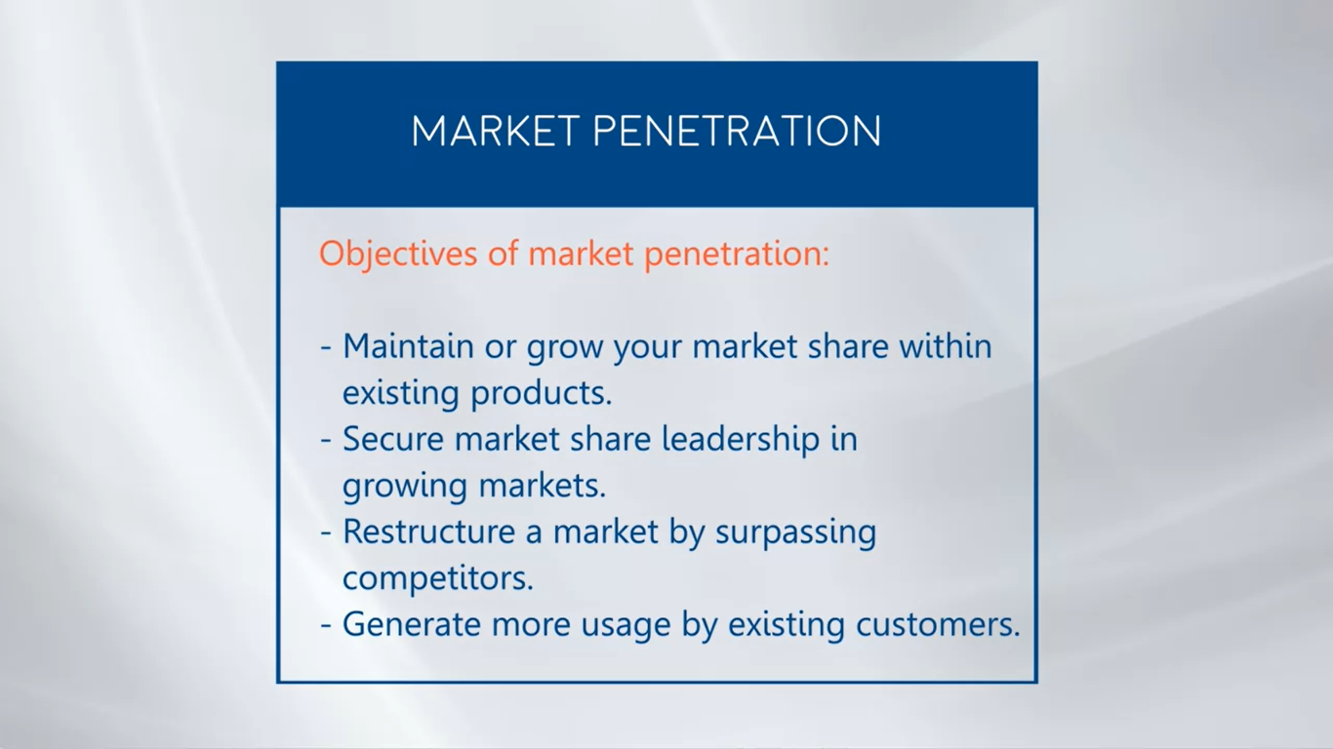

Slide 16
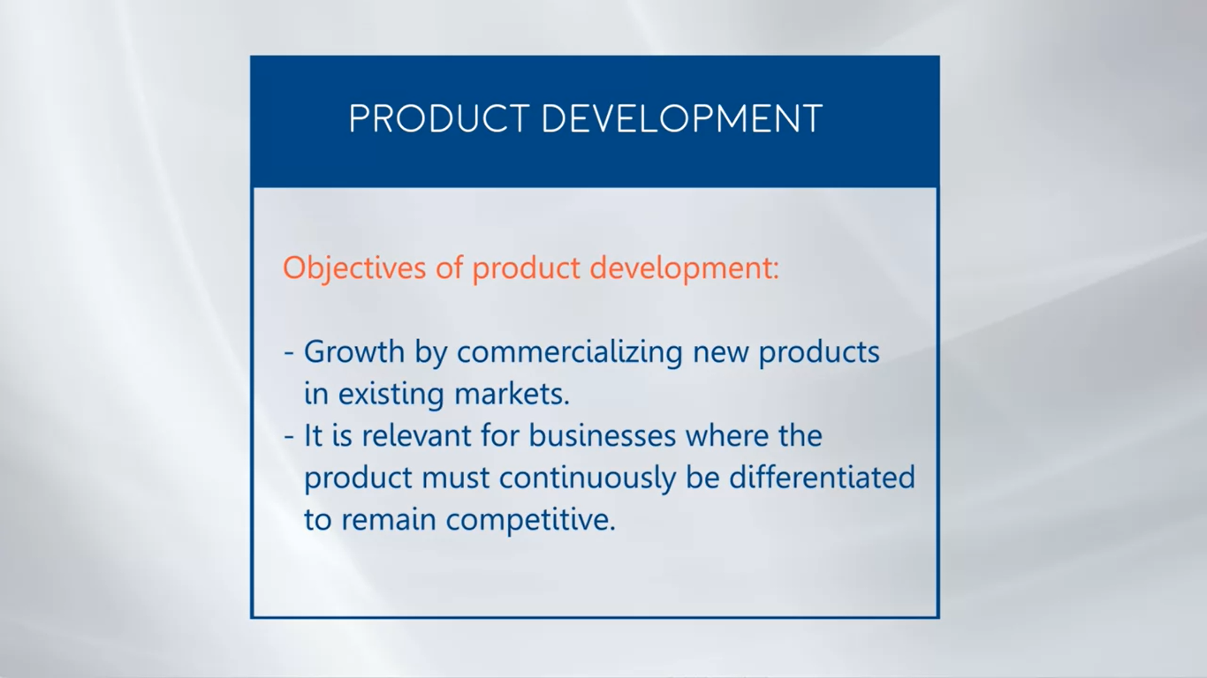

Slide 17
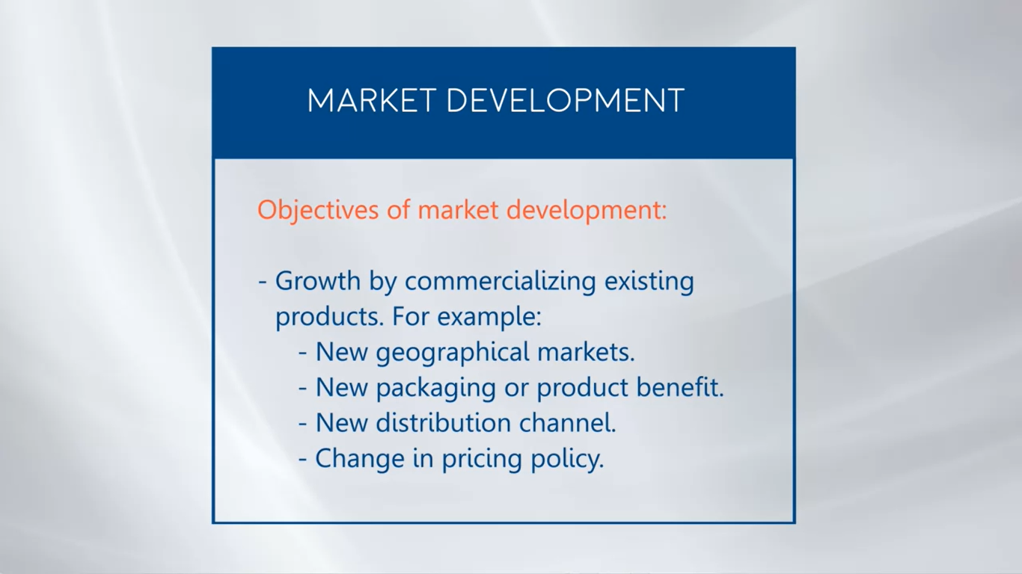

Slide 18
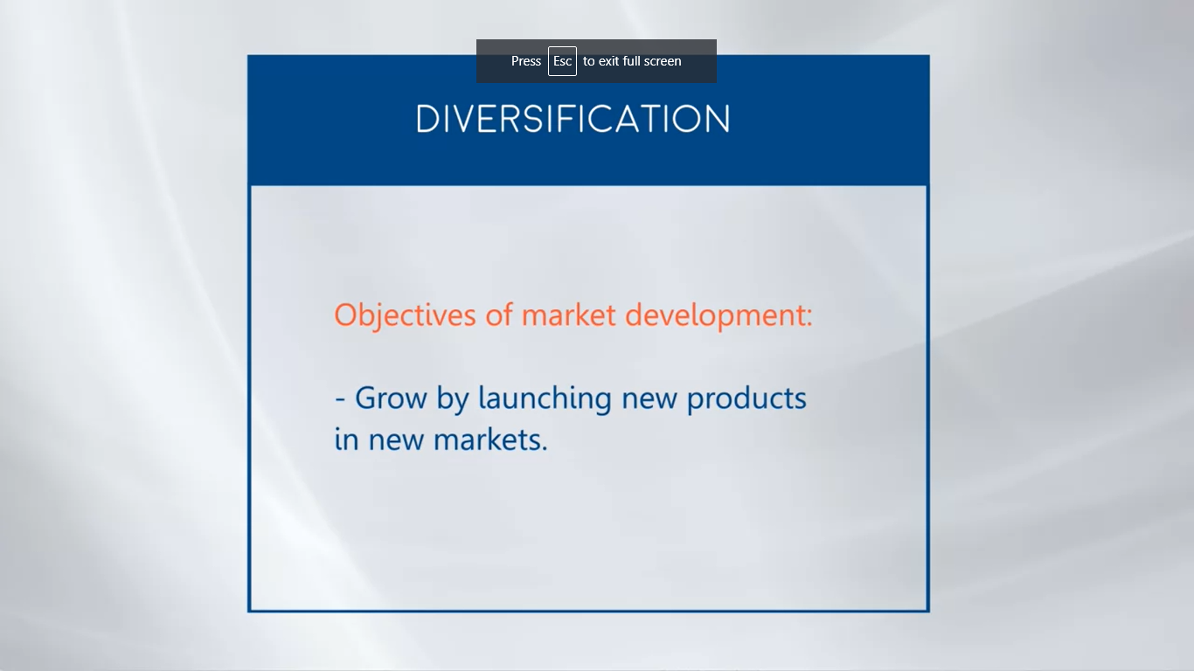

Slide 19
1.4 How to calculate demand for your product.

Slide 20
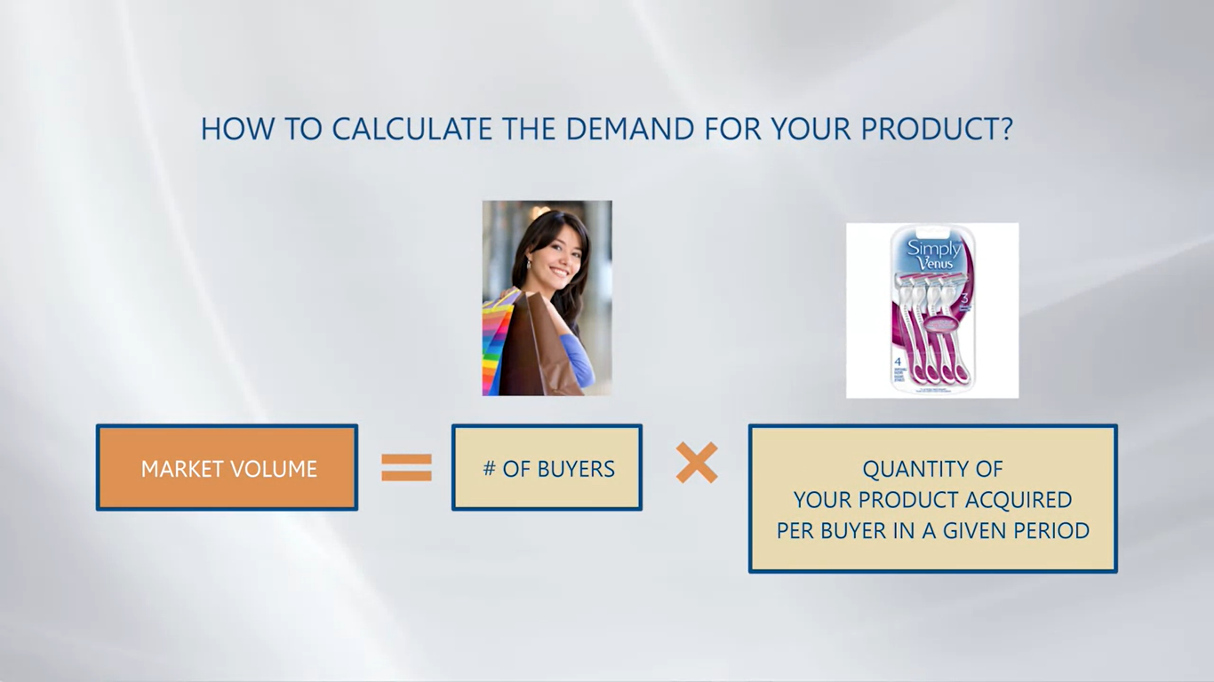

Slide 21
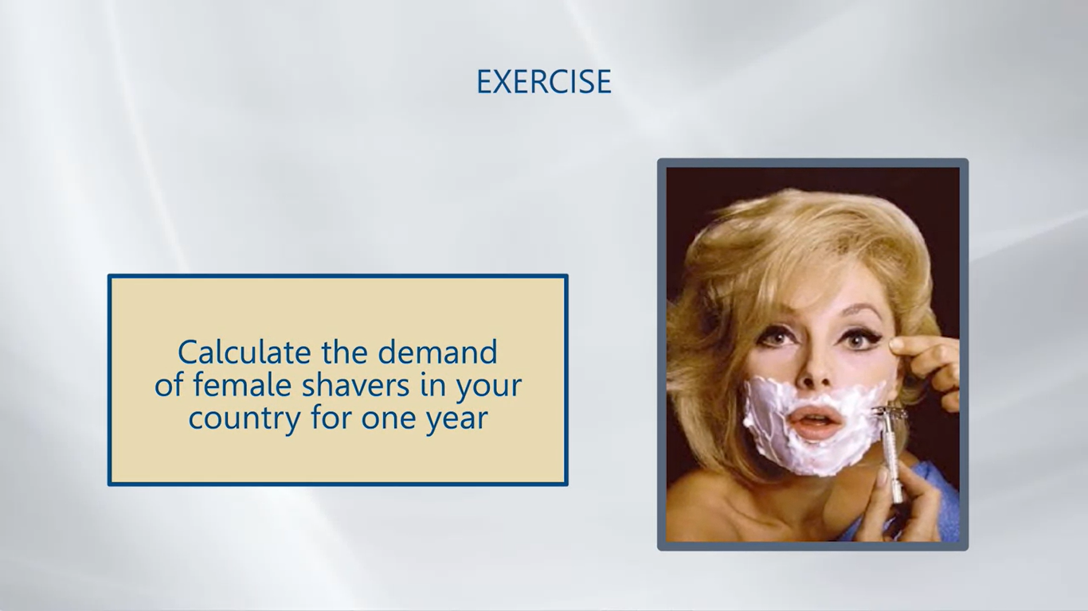

Slide 22
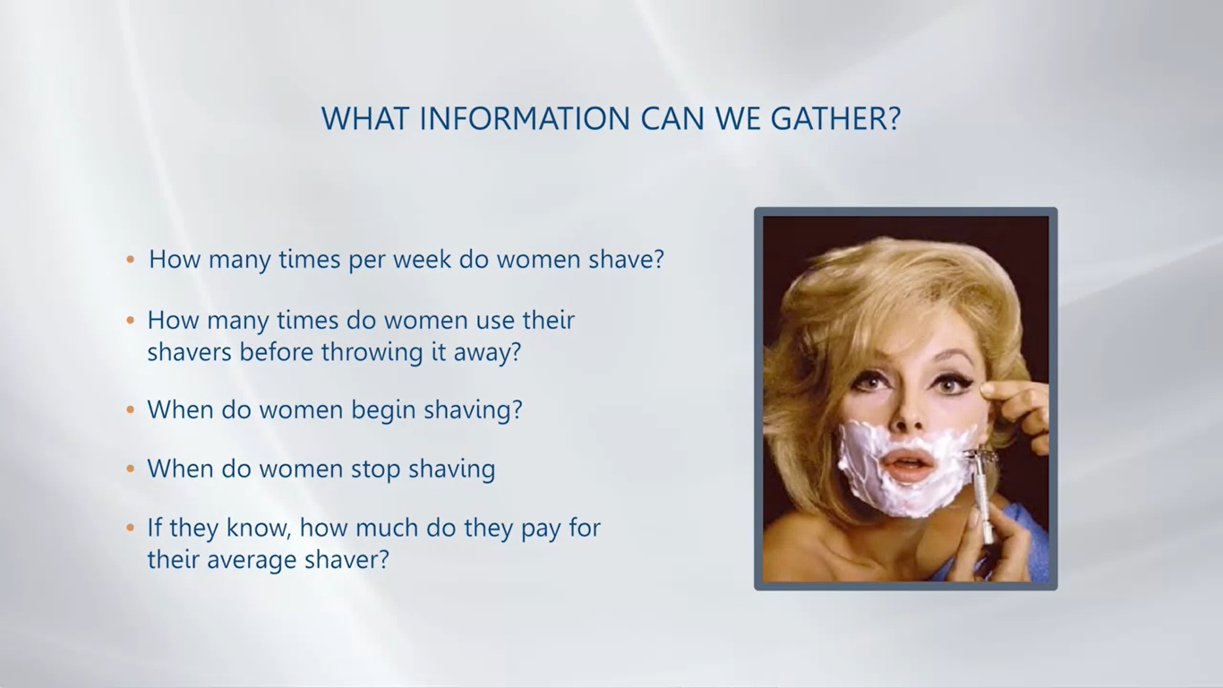

Slide 23
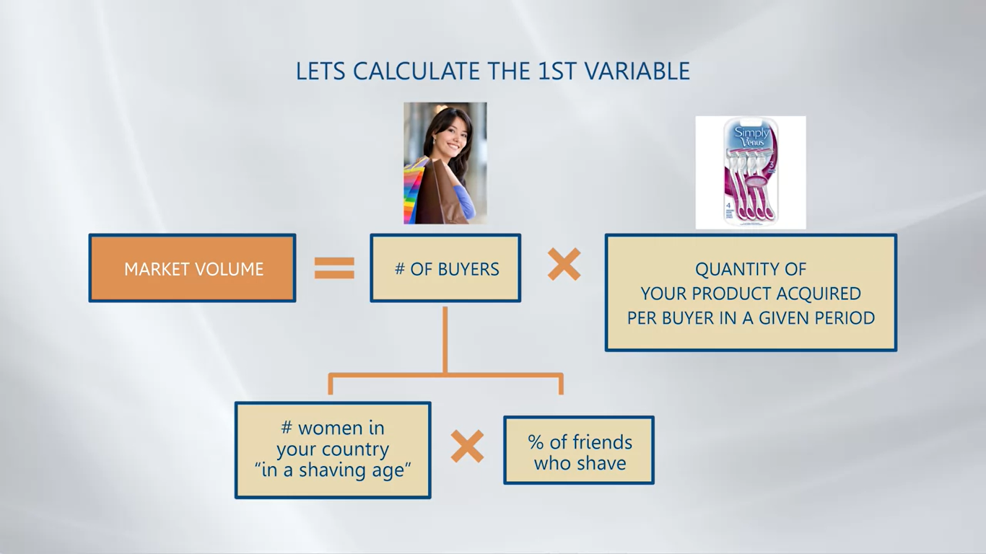

Slide 24
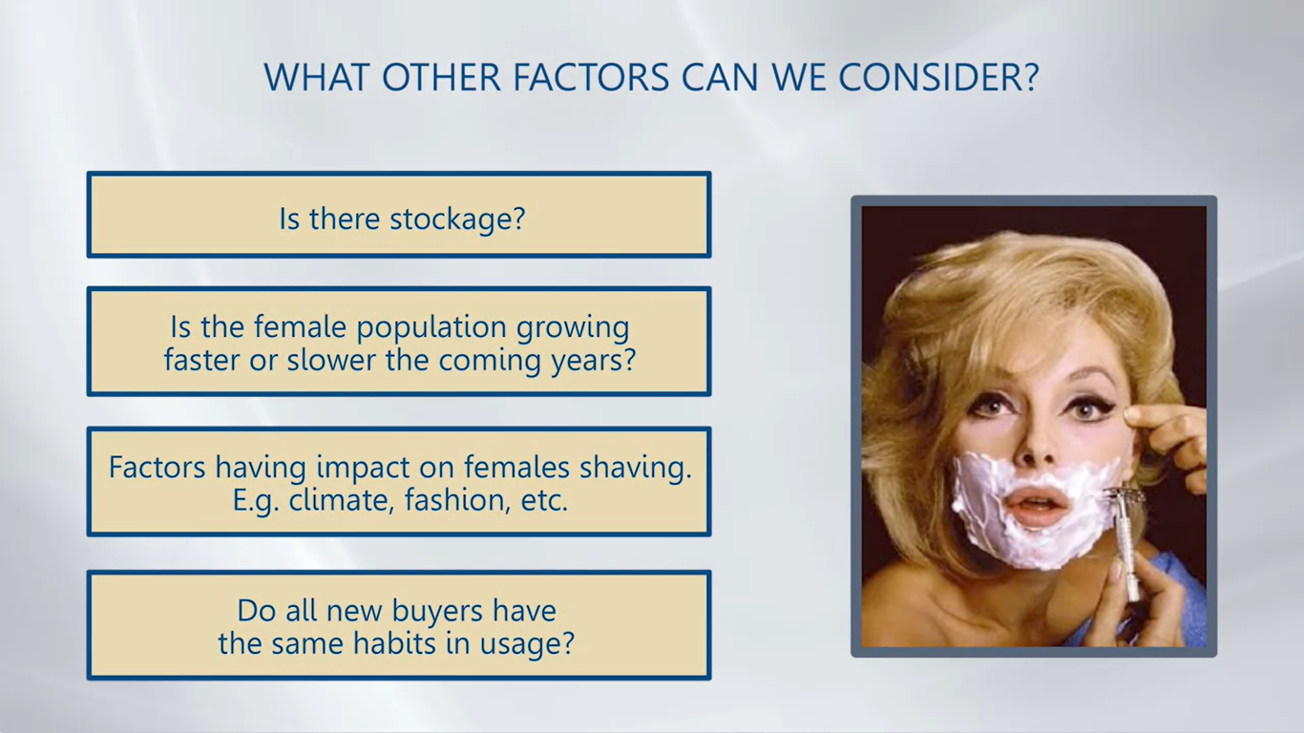

Slide 25
How to Estimate Market Demand
This article aims to explain the student how important is to understand the demand for your product, specially when it involves a small business.
Step by step you will learn how to calculate the demand for goods based on your sales and data of your consumers.
Click here to read more.

Slide 26
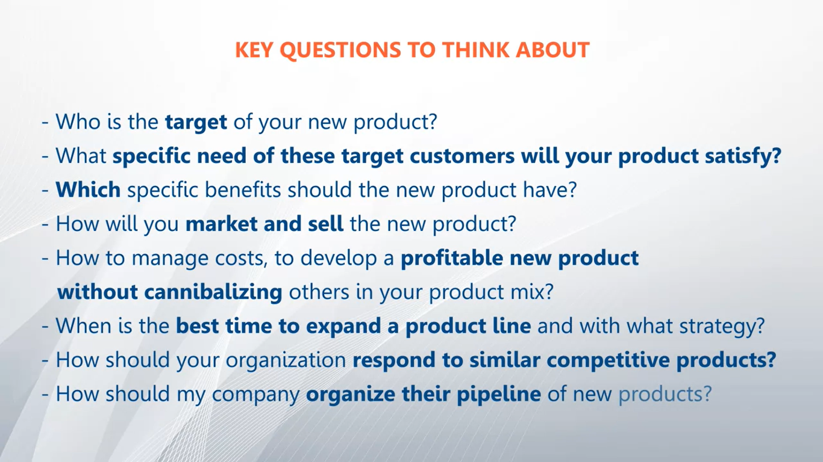
1.5 How to develop and launch new products.

Slide 27
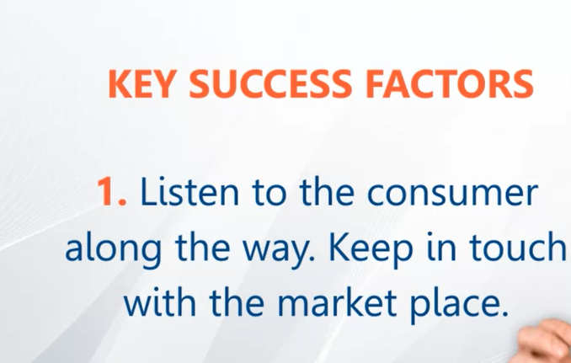

Slide 28
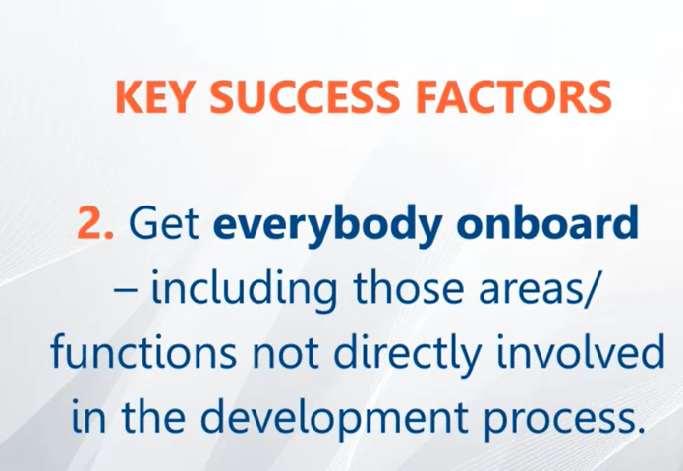

Slide 29
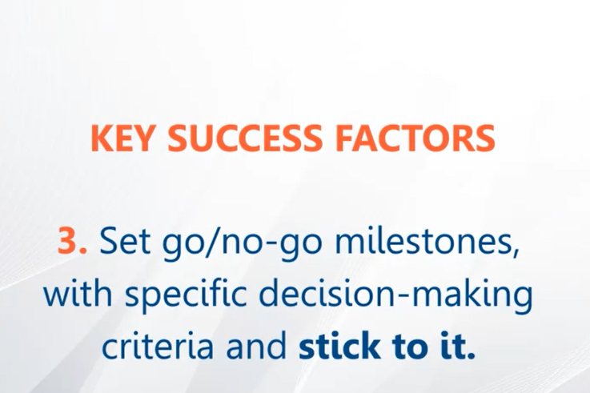

Slide 30
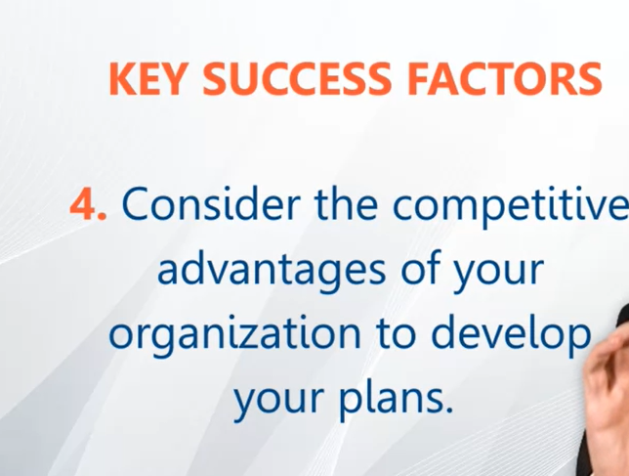

Slide 31
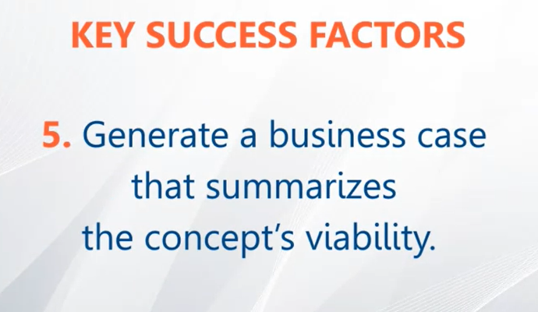

Slide 32
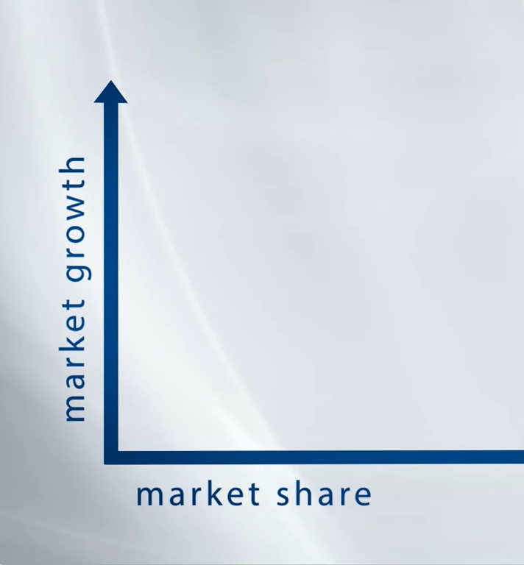
1.6 Defining your product pipeline.

Slide 33
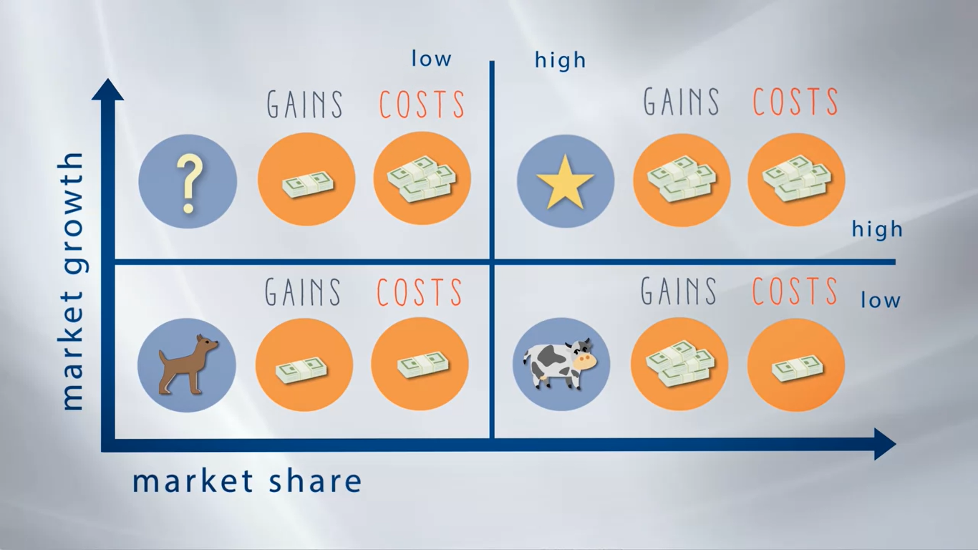

Slide 34
What are brands and how do you develop them?

Slide 35
2.0 What is a brand and why do you need one?
a brand is to be comfortable buying a product
A brand can be what a consumer thinks of a, once she or he listens the name of the brand.
A brand could be like a sort of promise a company makes to you, or
maybe also an experience you enjoy when you buy any specific product.

Slide 36
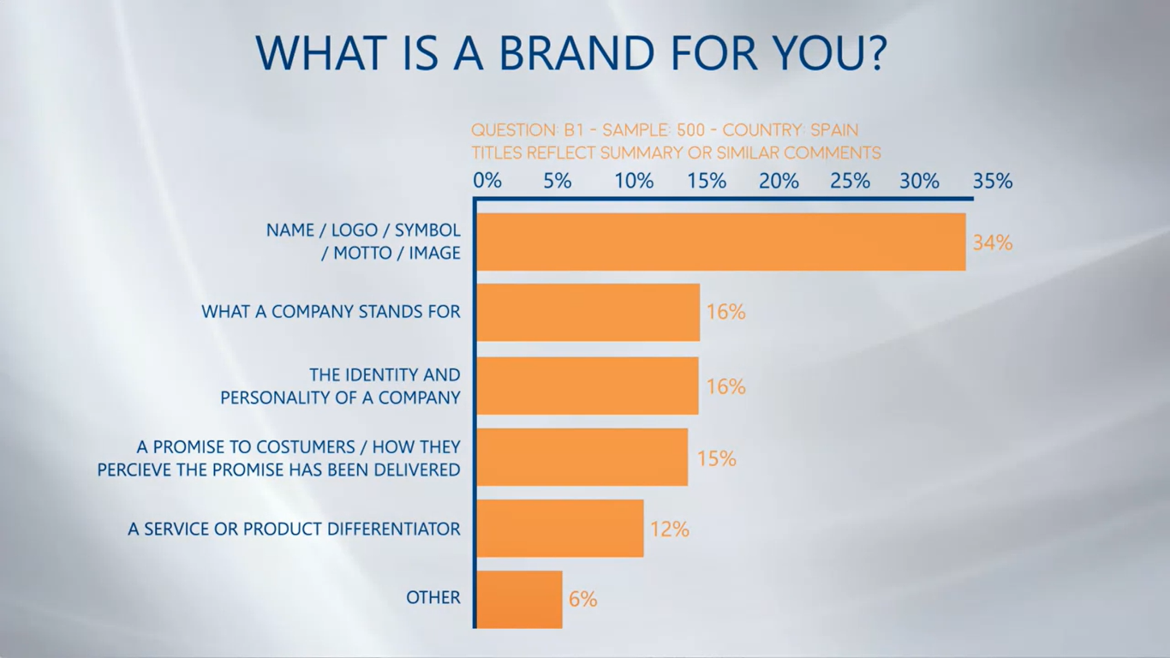

Slide 37
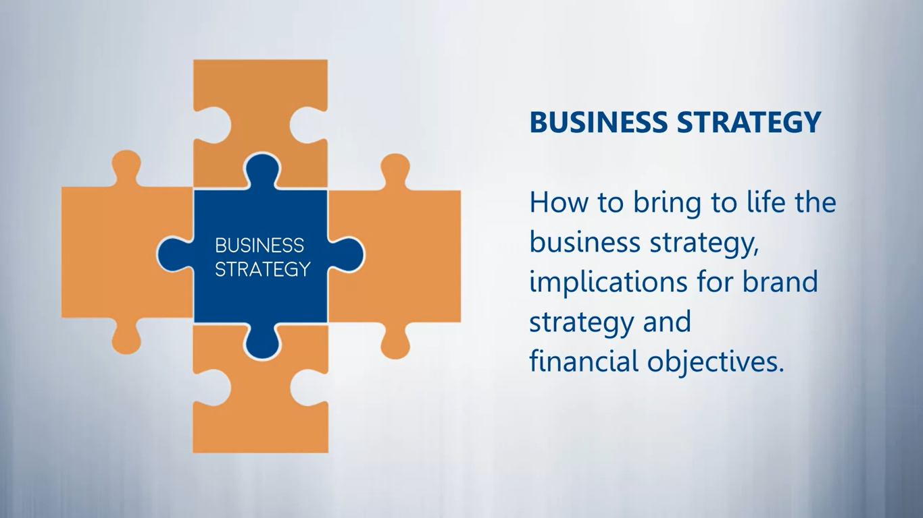
2.1 Inputs for developing your brand.

Slide 38
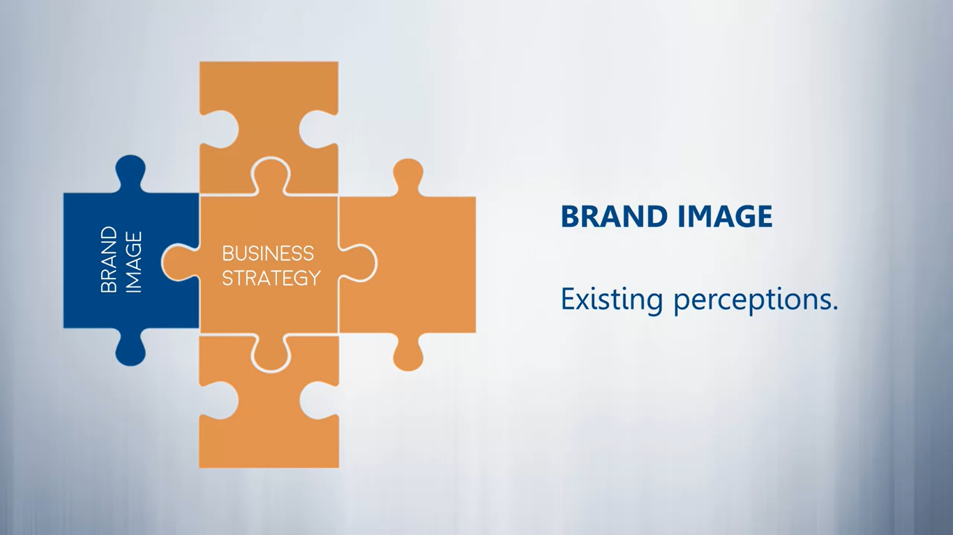

Slide 39
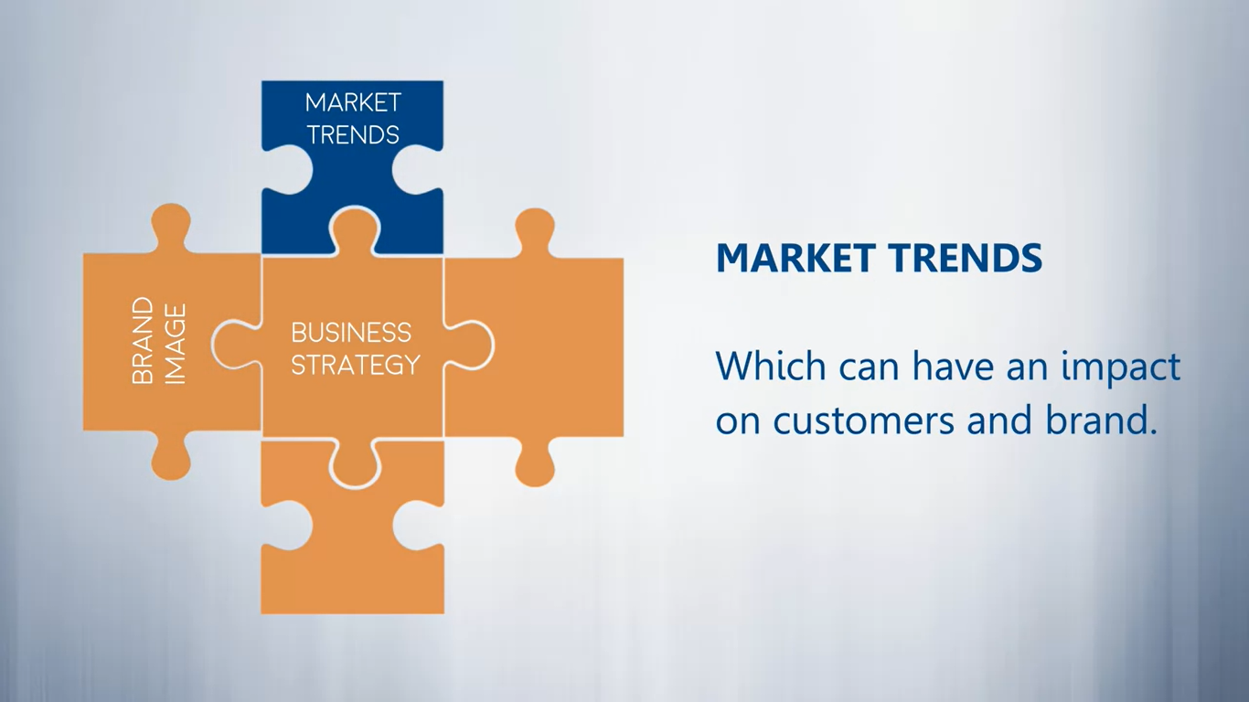

Slide 40
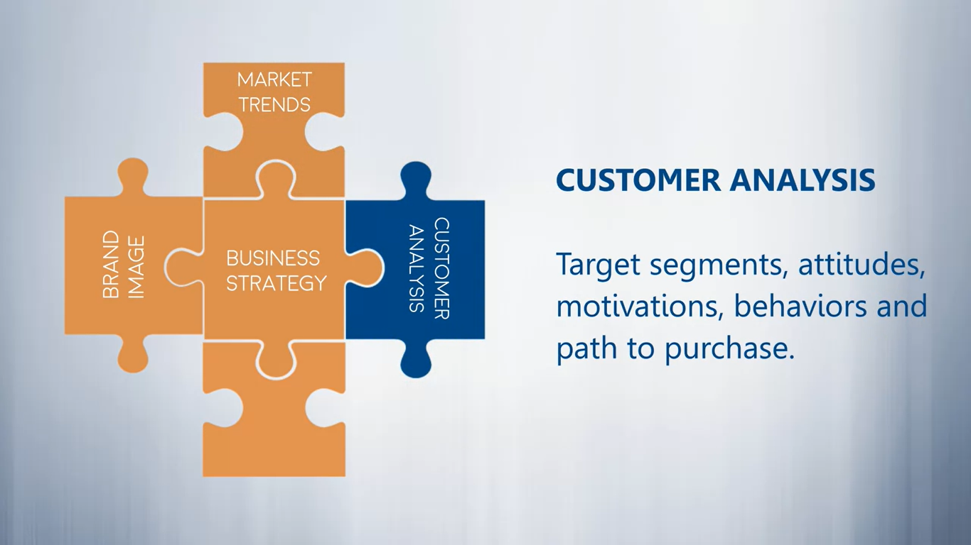

Slide 41
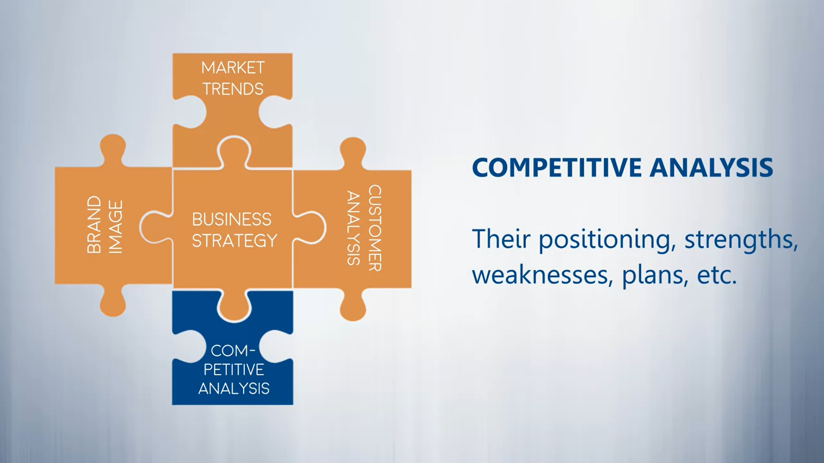

Slide 42
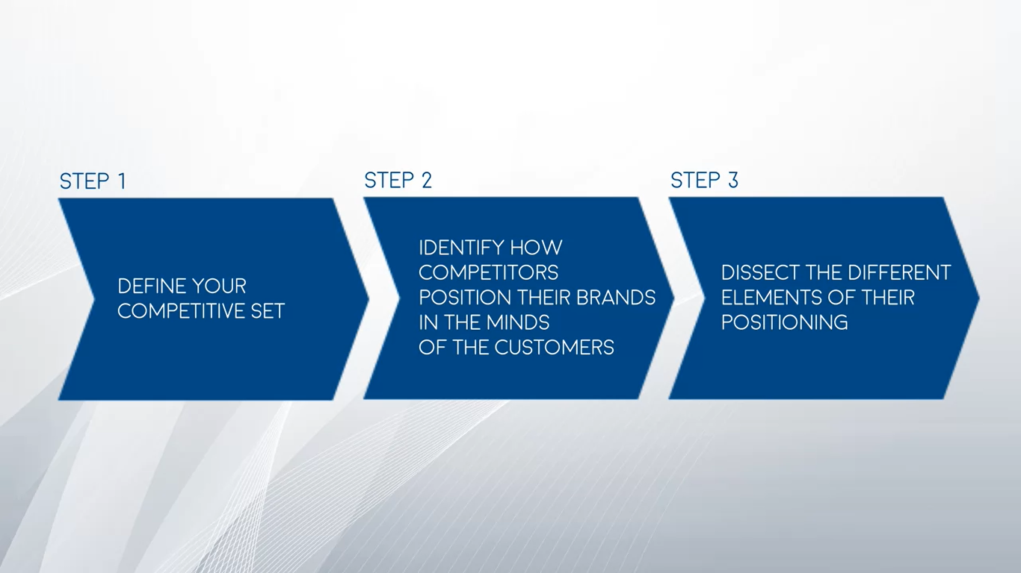
2.2 How to analyze your competitors.

Slide 43
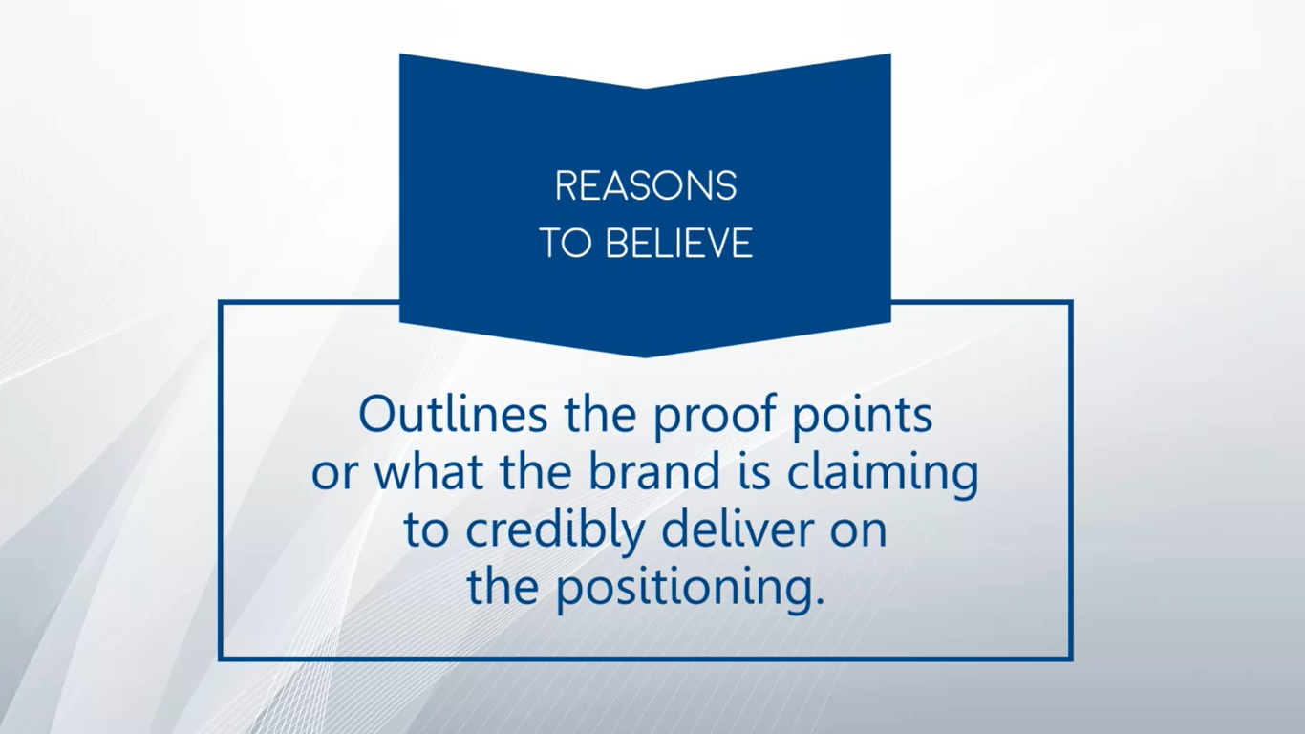

Slide 44
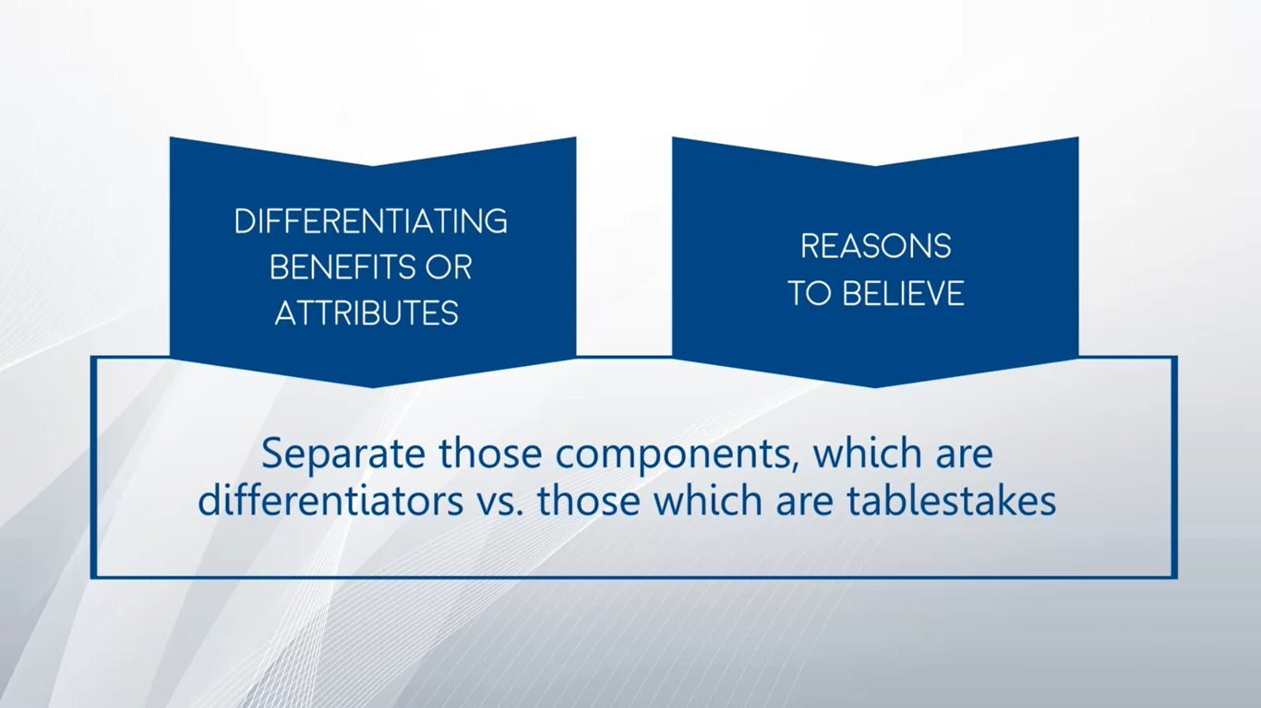

Slide 45
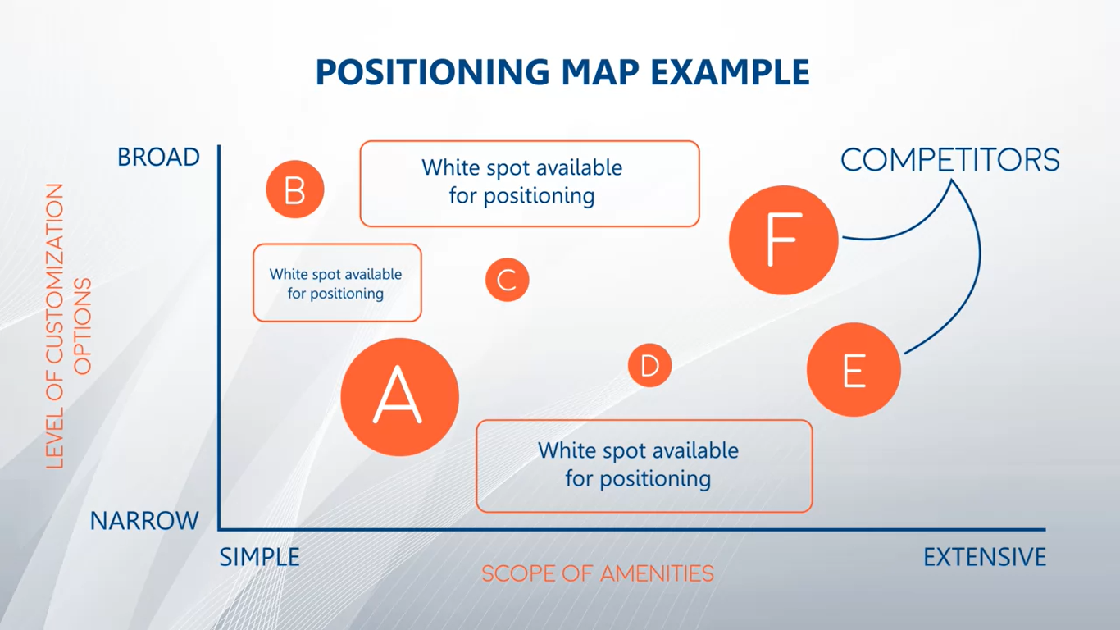

Slide 46
A Brand Guide: The Power of Branding
This guide will help you understand the power of branding and how to improve the perception of your product or service through brands.
This guide analyzes the term "brand" and all the different factors to take into account when generating an effective and powerful brand such as the key ingredients of a brand, why we need one, or how brands are changing nowadays.
The powerful brand of Coca-Cola will be used as an example along with the branding guide.
Read more here.

Slide 47
Defining your brand and its key elements.

Slide 48


Slide 49
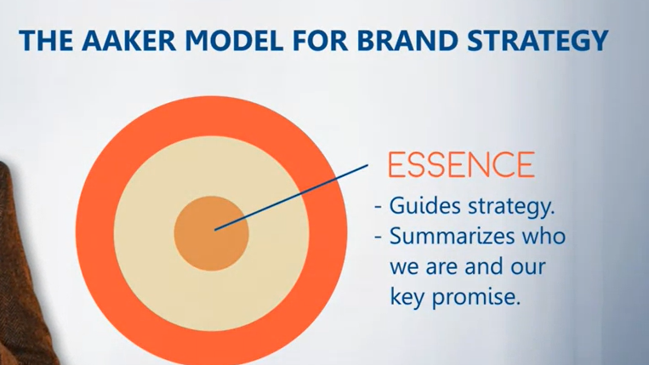

Slide 50
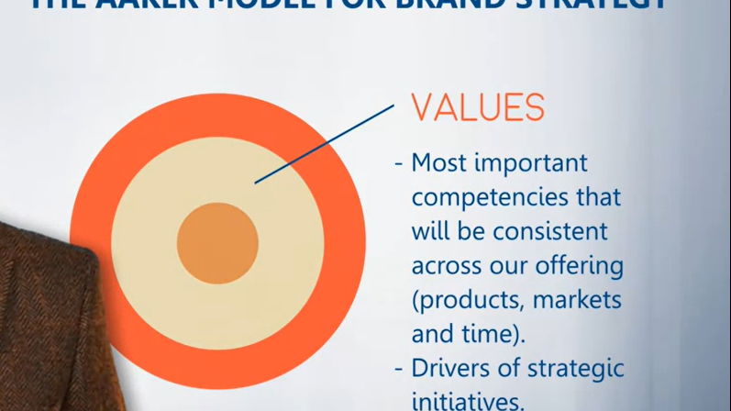

Slide 51
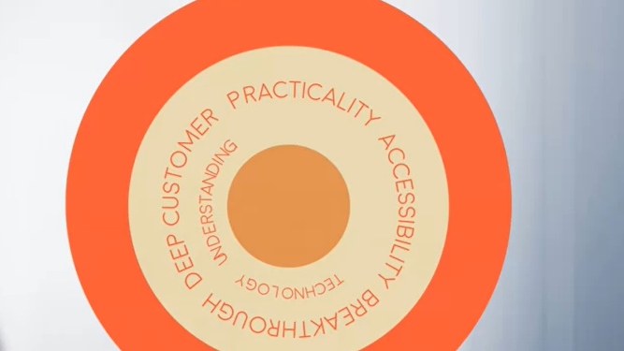

Slide 52
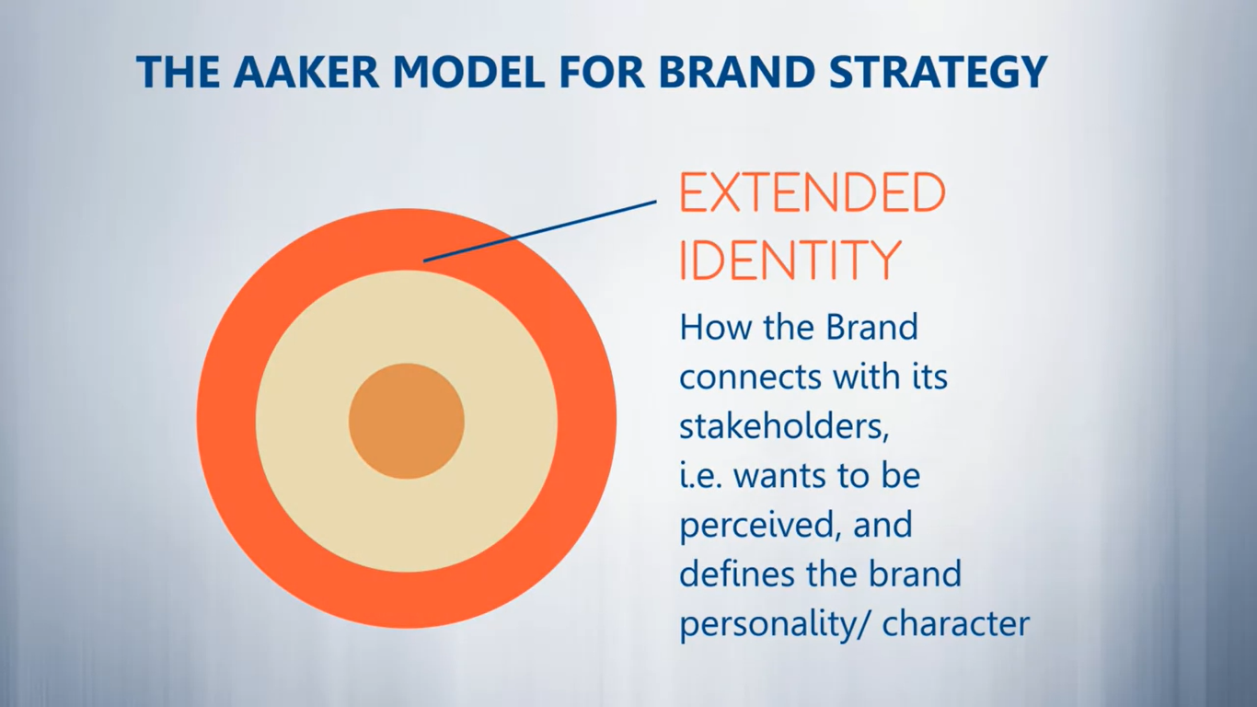

Slide 53
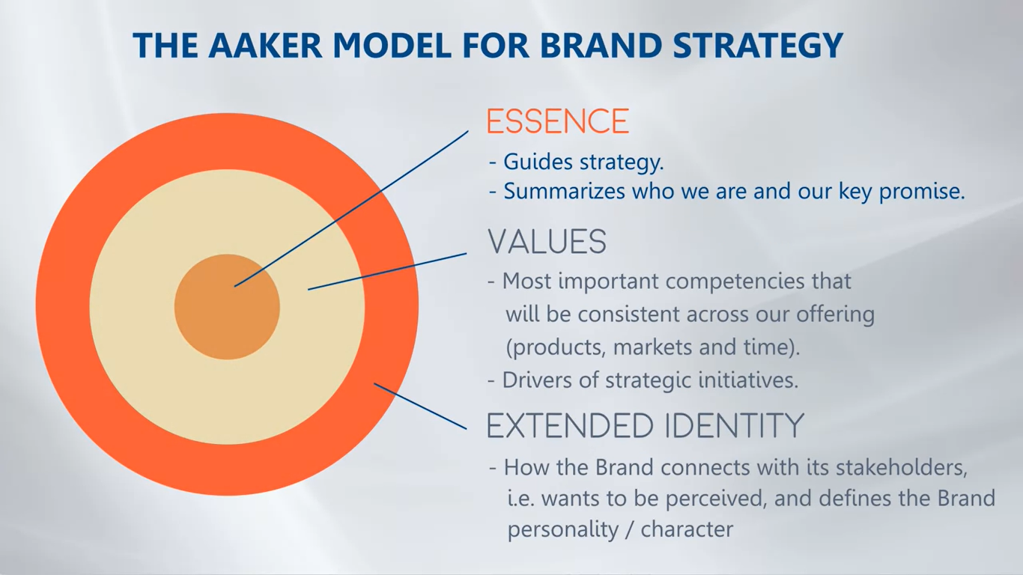

Slide 54
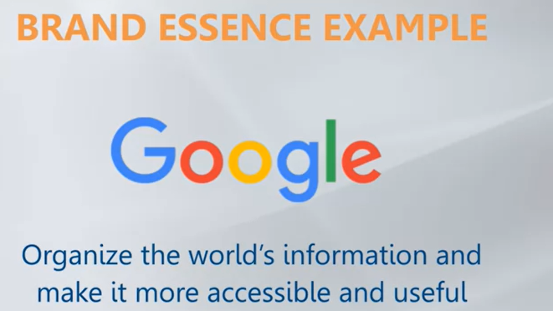

Slide 55
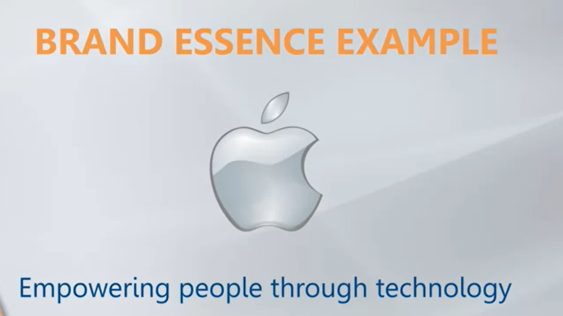

Slide 56
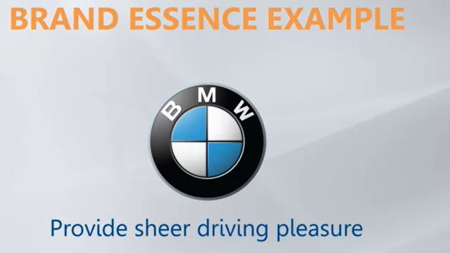

Slide 57
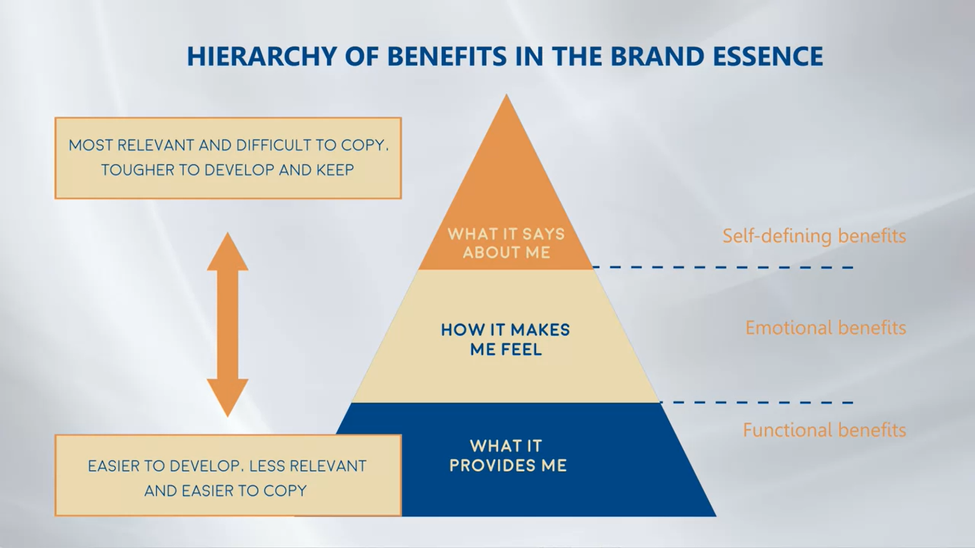

Slide 58
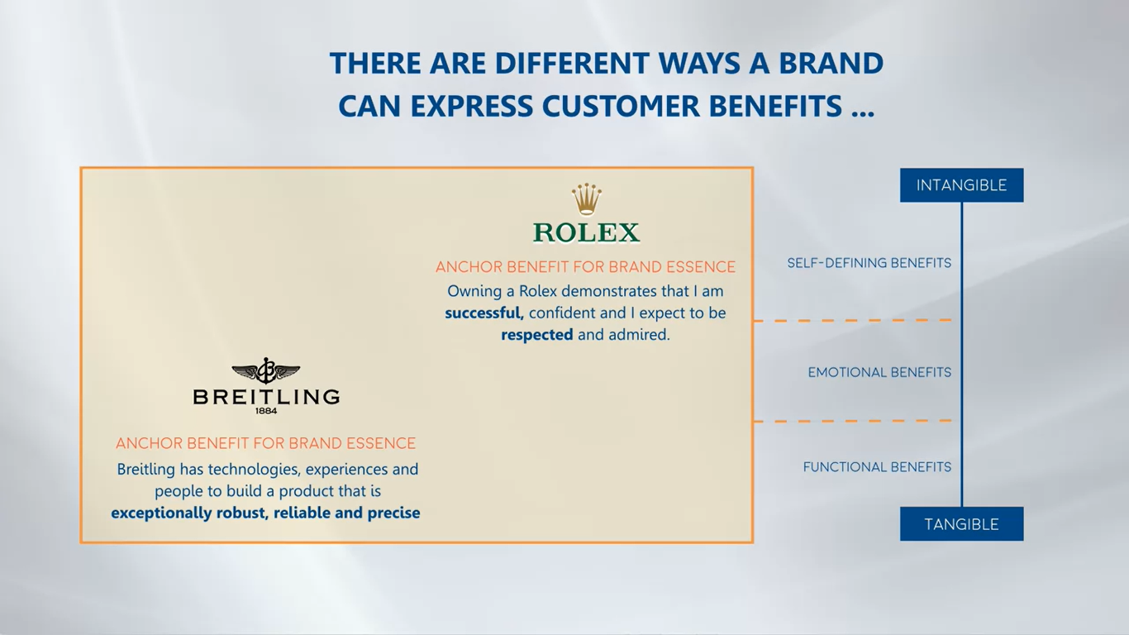

Slide 59
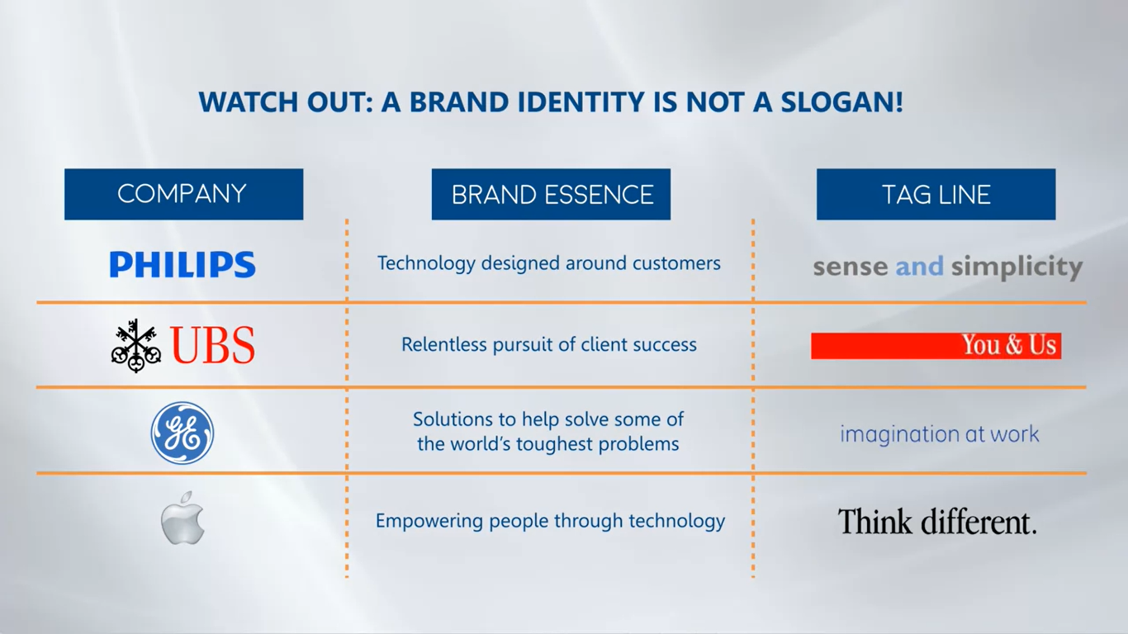

Slide 60
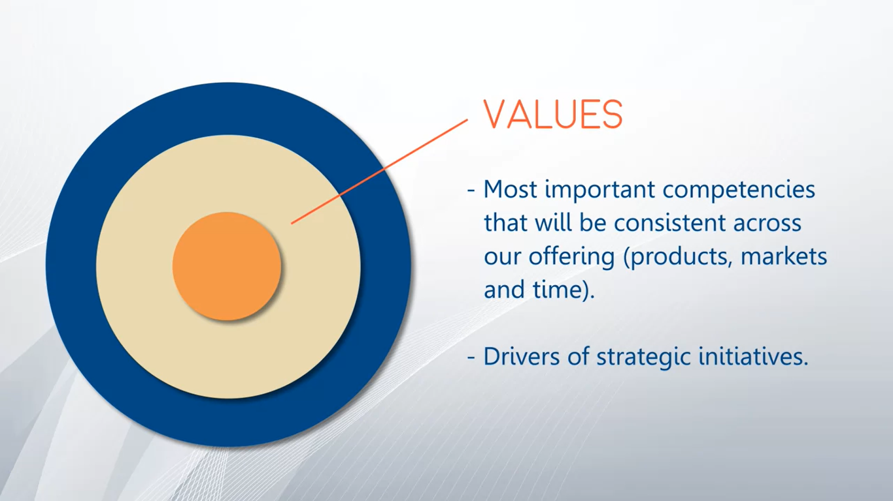

Slide 61
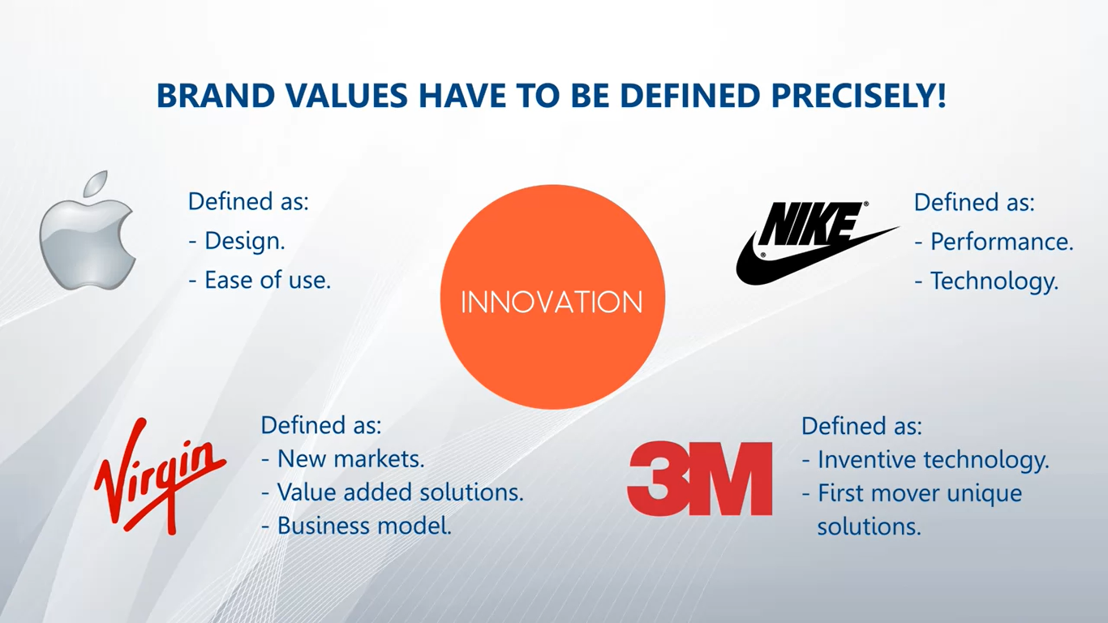

Slide 62
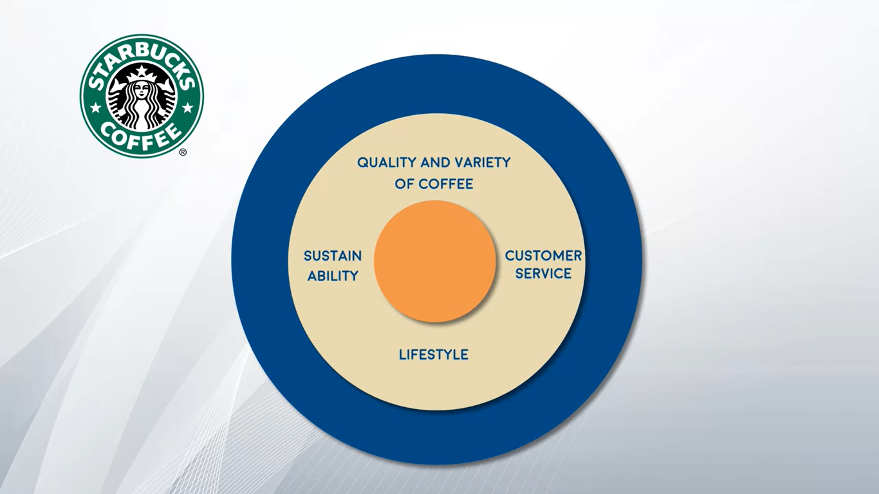

Slide 63
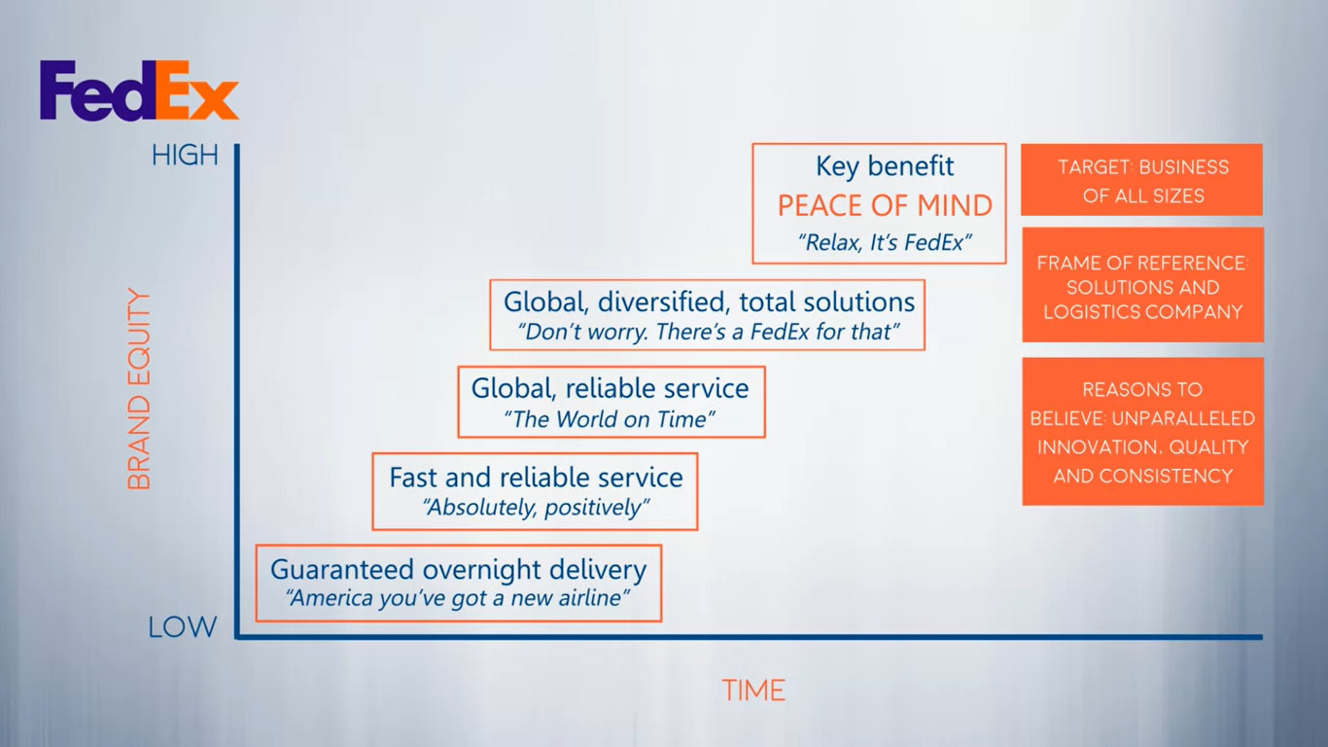

Slide 64
Developing your brand strategy.

Slide 65
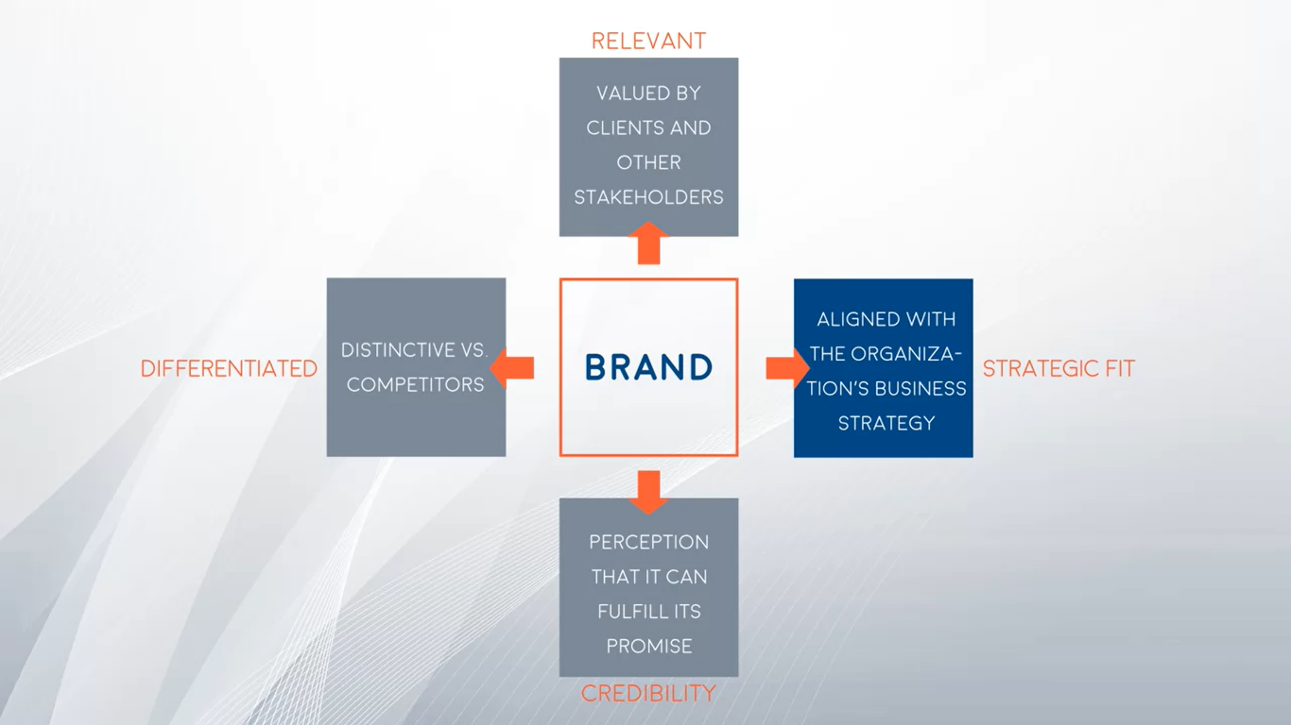

Slide 66
Introduction to brand architecture.

Slide 67

3.0 What Brand Architecture is and why you need it.

Slide 68


Slide 69
3.1 Brand equity and its relevance in your business.
brand equity can be explained as the additional money consumers
are willing to pay for a coke versus a no brand cola from the super market.
But in terms of companies, it is the additional money that an organization is willing to pay for the Coca Cola company versus another one.
For example, a critical situation for brand equity, is when the organization wants to expand into new markets and businesses. If it has a positive brand equity in that specific field, it is more likely that consumers will want to try the products, because of the association with a known brand.

Slide 70


Slide 71
Build Brand Equity
This article is a short and straight to the point reminder of what is brand equity and the steps to obtain it.
Click here to access it.

Slide 72

3.2 Which are the different models of brand architecture?

Slide 73


Slide 74


Slide 75


Slide 76


Slide 77


Slide 78


Slide 79
Models of brand architecture.

Slide 80

3.3 What a branded house is and when to use it.

Slide 81


Slide 82


Slide 83

3.4 What a house of brands is and when to use it.

Slide 84


Slide 85


Slide 86

3.5 What a hybrid model is and when to use it.

Slide 87


Slide 88


Slide 89


Slide 90
Developing your brand architecture.

Slide 91

3.6 How to develop a brand architecture - part 1.

Slide 92


Slide 93

How to develop brand architecture - part 2.

Slide 94

3.7 Top 5 indicators of a brand architecture issue or opportunity.

Slide 95


Slide 96


Slide 97


Slide 98

3.8 Things to consider when naming your brand.

Slide 99
Reading for Module 3 - Brand Relationship Spectrum
In order to access the readings, please use the following user and password:
User: iecoursera
Password: bb56321uy
Module 3 Reading: Brand Relationship Spectrum
Before reading the article, please review the following terms and conditions of use.

Slide 100
Reading for Module 3 - Leveraging the Corporate Brand
In order to access the readings, please use the following user and password:
User: iecoursera
Password: bb56321uy
Module 3 Reading: Leveraging the Corporate Brand
Before reading the article, please review the following terms and conditions of use.

Slide 101
Week3: Building your brand portfolio

Slide 102

4.0 What a product and brand portfolio is and why you need to define it.

Slide 103


Slide 104
From a brand perspective, how do you deal with the situation, do you continue
launching brands, do you use existing brands, do you re-position your brands?
That is why brand portfolio strategy was born. It is the finest, effective creation deployment and management of brand assets to support top and bottom line growth. The objective of the grand portfolio is to maximize its value by strategically growing, leveraging, and protecting brands to ensure
optimal coverage across a market with minimal overlap.
It will allow us to determine the right number of product and brands, and thus,
rationalize our portfolio to achieve economies of scale.
Determine the right level of investment for each brand.

Slide 105

4.1 What is the relationship between brand portfolio and brand architecture?

Slide 106


Slide 107


Slide 108
4.2 How to develop your brand portfolio
For example, between Gatorade and Powerade.
So how do you develop a brand portfolio strategy?
We will talk about five steps.
1. First one is, connecting the brand to business impacts.
2. Second is, building a fact base.
3. Third is, developing customer insights.
4. Fourth is, creating portfolio scenarios.
5. And five is, to define a roadmap to achieve growth.

Slide 109

4.3 Managing your brand portfolio

Slide 110


Slide 111


Slide 112


Slide 113


Slide 114


Slide 115


Slide 116


Slide 117


Slide 118


Slide 119


Slide 120


Slide 121


Slide 122
Reading for Module 4 - Making brand portfolios work
In order to access the readings, please use the following user and password:
User: iecoursera
Password: bb56321uy
Module 4 Reading: Making brand portfolios work
Before reading the article, please review the following terms and conditions of use.

Slide 123
Introduction to the customer experience journey.

Slide 124

5.0 The customer experience journey.

Slide 125


Slide 126


Slide 127


Slide 128


Slide 129

5.1 What is the purchase funnel?

Slide 130


Slide 131


Slide 132


Slide 133


Slide 134
How to understand my customer's experiences with a product? Use the Customer Experience Journey Tool
Access the video clicking here.

Slide 135

The touchpoints of your brand.

Slide 136


Slide 137


Slide 138


Slide 139


Slide 140

5.3 Identifying your touchpoints.

Slide 141


Slide 142


Slide 143

5.5 Defining the touchpoints roles

Slide 144

5.6 Implementing the brand at the key touchpoints.

Slide 145


Slide 146
Embedding the brand through a brand engagement program.

Slide 147



Slide 148


Slide 149
The brand engagement program works at three levels.
At the rational level, because we need employees to understand what is the essence and the values of the brand so they can guide their business decisions.
Second, at a behavioral level, because we need them to have the tools that help them apply the brand at each assigned touch point.
in our experience, is most important in generating actual change,
is to convince them at an emotional level, because by providing a meaningful purpose of they can relate to.

Slide 150


Slide 151


Slide 152

6.1 Defining your internal communication and training program.

Slide 153


Slide 154


Slide 155


Slide 156


Slide 157


Slide 158


Slide 159

6.2 Embedding the brand throughout the organization

Slide 160


Slide 161


Slide 162

6.3 Measuring and tracking internal brand behavior

Slide 163


Slide 164


Slide 165
Thank You

